Slide 1


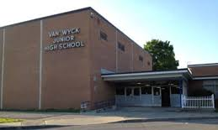






Welcome
to
Summer Reading 2020!
I’m
Mrs. Green from WJHS!
I’m
Mrs. Basuljevic (Mrs. B) from VWJHS!
Click PRESENT
to begin!

Slide 2

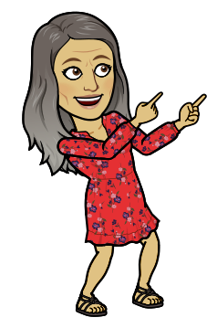
Click HERE to meet
the Junior High
Librarians!
Please be sure to go through the entire presentation to view the information for summer reading!

Slide 3







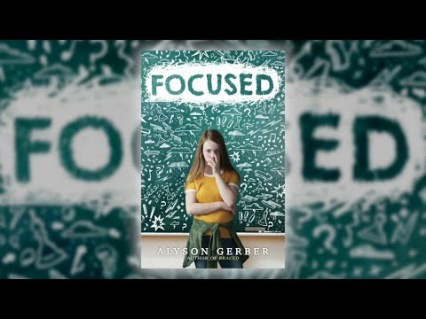
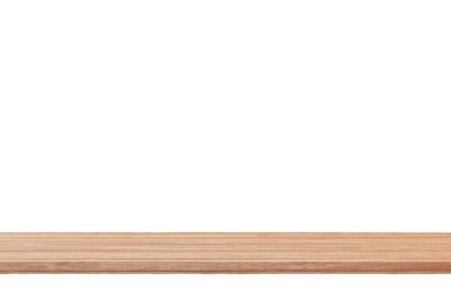











Click on a book cover
to hear about it from
a junior high librarian!

Slide 4
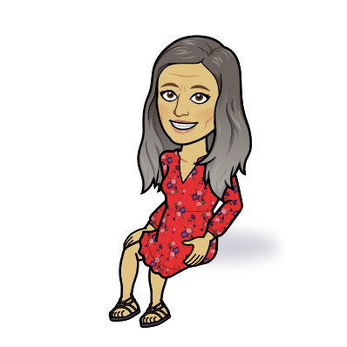
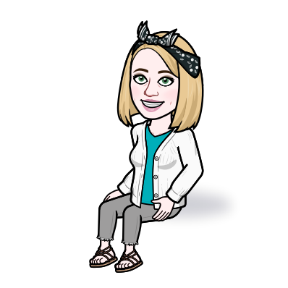
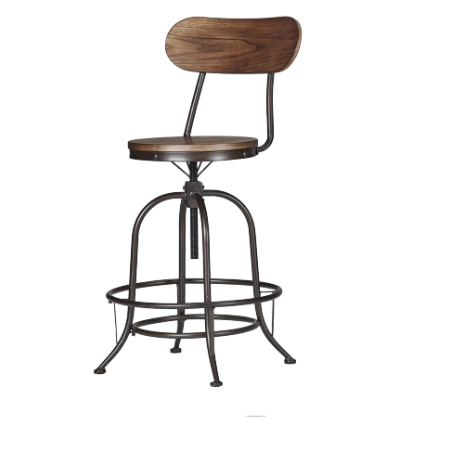
Mrs. B and
Mrs. Green here!
We wanted to share
some links with
you for your
summer reading!

Slide 5
If NOT, go HERE
to register for one
(online), and then
you'll be able to
access FREE
eBooks!
FIRSTLY, do you
have a PUBLIC
library card?

Slide 6
The LIBBY and HOOPLA apps
are what the public libraries
use to access eBooks and other digital
resources. Download one
(or BOTH) to your device.

Slide 7
After adding the app(s),
make sure to add your
library card number.
Once you've done that,
you can check out eBooks,
request holds for others,
AND check out movies!

Slide 8
Another GREAT site to go
to for free eBooks is
TeenBookCloud!
Username: tumble2020
Password: A3b5c6

Slide 9
There are some
GREAT audiobooks
on Audible!

Slide 10

Feel free to reach out
to either of us if you
need help with any
of the eBook resources
we shared with you!
We hope you have a
WONDERFUL summer!
EMAIL

